Slide 1
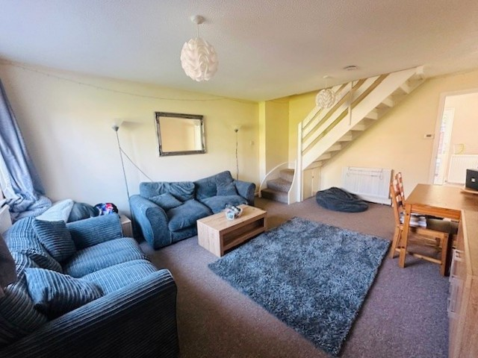
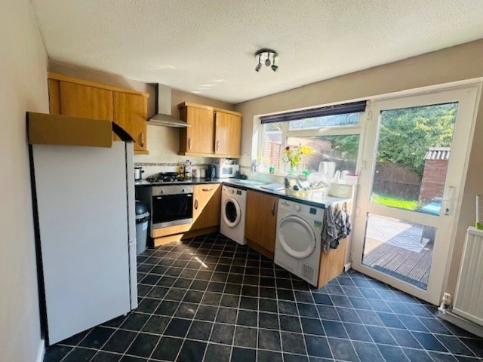
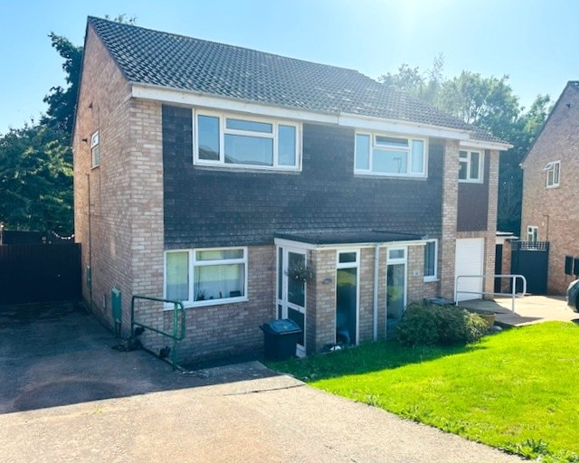
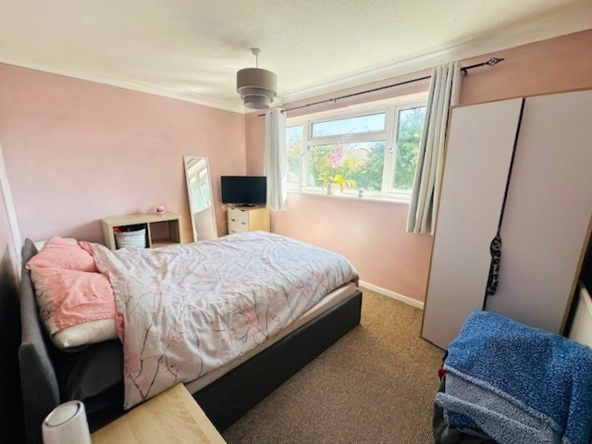
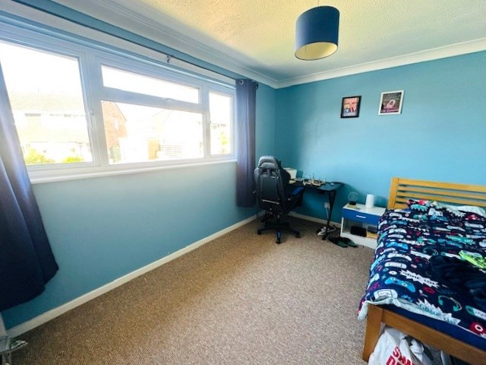
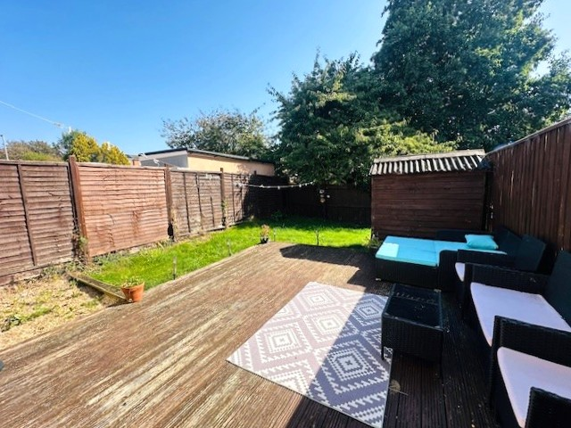
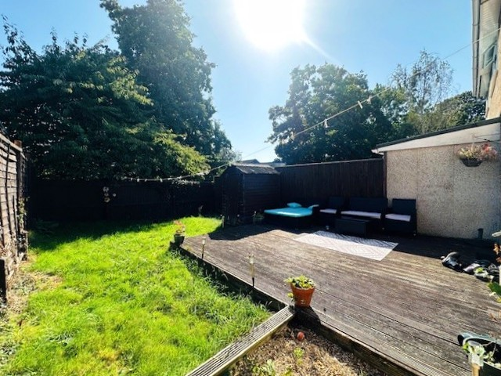
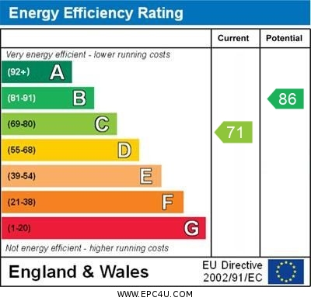
www.pennys.net
3 Hollymount Close, Exmouth, EX8 5PQ
GUIDE PRICE £269,950
TENURE Freehold
A Well Presented Two Double Bedroom Semi-Detached House Situated In A Most Favoured Location Close to Amenities With Driveway Parking And Generous Enclosed Rear Garden
Viewing Recommended - Ideal For First Time Buyers Or Investment
Entrance Porch * Lounge / Dining Room * Modern Kitchen / Breakfast Room * Two Double Bedrooms * Bathroom / WC * Gas Central Heating * Double Gazed Windows * Driveway Parking * Pleasant Gardens
Pennys Estate Agents Limited for themselves and for the vendor of this property whose agents they are give notice that:- (1) These particulars do not constitute any part of an offer or a contract. (2) All statements contained in these particulars are made without responsibility on the part of Pennys Estate Agents Limited. (3) None of the statements contained in these particulars are to be relied upon as a statement or representation of fact. (4) Any intending purchaser must satisfy himself/herself by inspection or otherwise as to the correctness of each of the statements contained in these particulars. (5) The vendor does not make or give and neither do Pennys Estate Agents Limited nor any person in their employment has any authority to make or give any representation or warranty whatever in relation to this property.
PENNYS ESTATE AGENTS
2 Rolle House, Rolle Street, Exmouth, Devon, EX8 2SN
Tel: 01395 264111 EMail: help@pennys.net

Slide 2
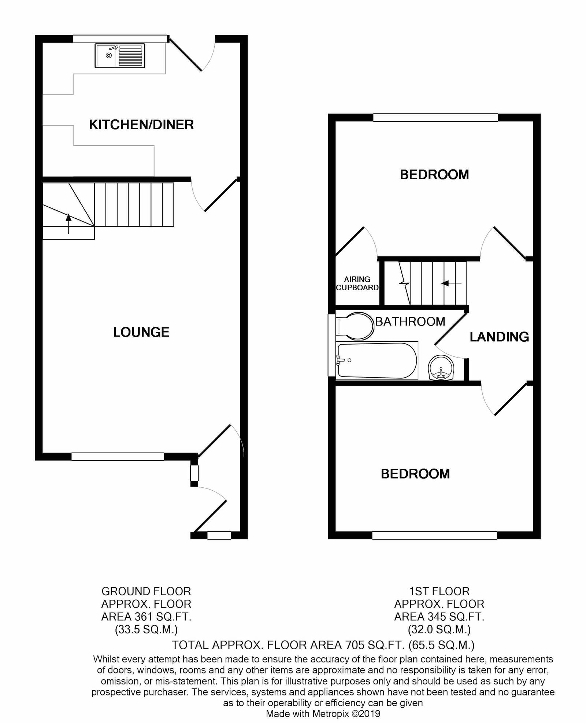
3 Hollymount Close, Exmouth, EX8 5PQ
THE ACCOMMODATION COMPRISES: Double glazed front door with inset patterned glass giving access to:
ENTRANCE PORCH: Double Glazed window with obscure glass; radiator; coat rack; inner glazed door with obscure glass leading to:
LOUNGE / DINING ROOM: 5.33m x 3.96m (17'6" x 13'0") A bright spacious open plan room with uPVC double glazed window to front aspect; two radiators ; television point; stairs rising to first floor with useful understairs storage cupboard; thermostat and timer control for central heating; glazed door with obscure glass leading to:
KITCHEN / BREAKFAST ROOM: 3.96m x 2.72m (13'0" x 8'11") A modern fitted kitchen with a useful space for a breakfast table or additional storage; comprising of range of patterned worktop surfaces; inset single drainer sink unit with mixer tap over; base cupboards; drawer unit; space and plumbing for washing machine and dishwasher / tumble dryer beneath work surfaces; inset four ring gas hob with stainless steel chimney style extractor hood over and built in single oven below; appliance space for tall standing fridge / freezer; matching eye-level wall units; attractive tiled surrounds; radiator; vinyl flooring; uPVC double glazed window overlooking the rear aspect and uPVC double glazed door giving access to the rear garden.
FIRST FLOOR LANDING: With access to roof space; radiator; doors leading to:
BEDROOM ONE: 3.96m x 2.97m (13'0" x 9'9") uPVC double glazed window overlooking the front aspect; radiator; ceiling light.
BEDROOM TWO: 3.96m x 2.74m (13'0" x 9'0") uPVC double glazed window to the rear aspect; linen cupboard over stairwell recess housing modern boiler providing hot water and central heating; radiator.
BATHROOM / WC: Fitted with a white suite comprising of bath with shower unit over; shower curtain and rail; pedestal wash hand basin with mixer tap over; fitted mirror fronted storage above; WC with push button flush; chrome heated towel rail; ceiling extractor fan; uPVC double glazed obscure glass window over side aspect.
OUTSIDE: To the front of the property is a lawned area of garden edged with flower and shrub beds; a driveway runs alongside the property providing off road parking. A few steps lead down to the front patio area and entrance door. Accessed via a wooden gate is a pleasant and generously sized REAR GARDEN which is fully enclosed by timber fencing and comprises a decked sun terrace ideal for outside entertaining; lawned area of garden; timber garden shed; outside tap.
Mortgage Assistance: We are pleased to recommend Meredith Morgan Taylor, who would be pleased to help no matter which estate agent you finally buy through. For a free initial chat please contact us on to arrange an appointment. Your home may be repossessed if you do not keep up repayments on your mortgage. Meredith Morgan Taylor Ltd is an appointed representative of The Openwork Partnership, a trading style of Openwork Ltd which is authorised and regulated by the Financial Conduct Authority (FCA).
FLOOR PLAN:

